Slide 1
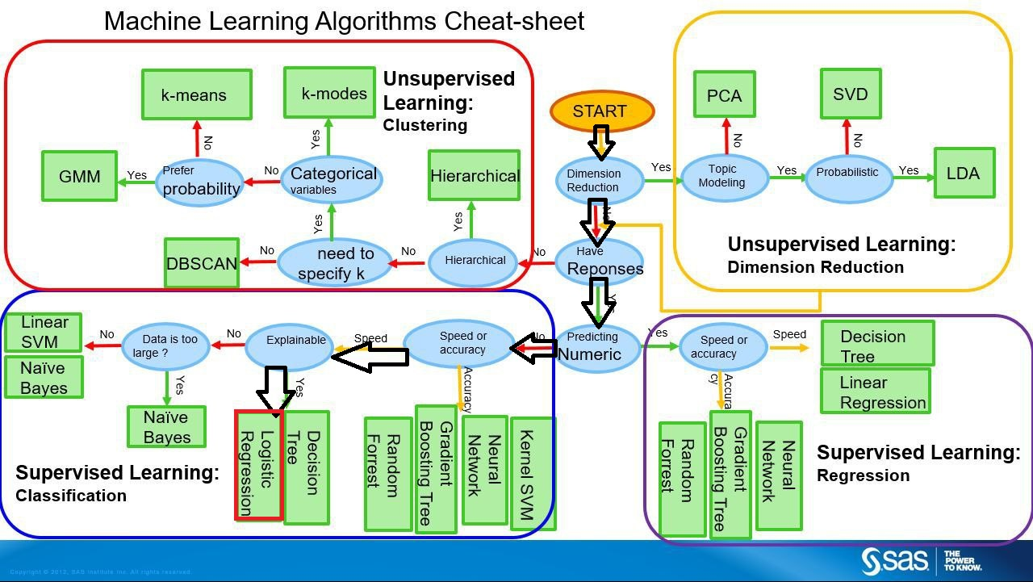

Slide 2
Many industries can manufacture food , But only some can preserve food efficiently and profitably.
Outcome: Preservability of Material

Slide 3
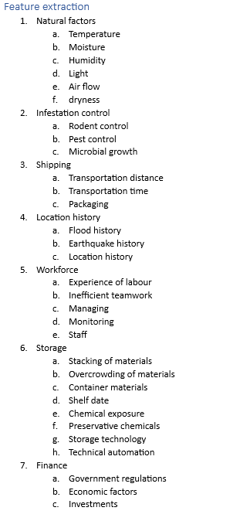
Feature Engineering
After considering the created features, we went through the phase of feature selection and reduction and extracted the following features
1. Natural_Factors
2. Infestation_control
3. Shipping
4. Location_history
5. Work_Force
6. Storage
7. Finance

Slide 4
OUTCOME AND BUSINESS’USECCASE
The major outcome we get from this model is preservability.
BUSINESS USE CASE: Preserving the food is one of the major challenge that food manufacturing industry is facing now a days. By analyzing the data accurately at each and every step of manufacturing and storing process we can ace the preservability of a food material. As the preservability increases it in turn increase the profitability of the company.

Slide 5
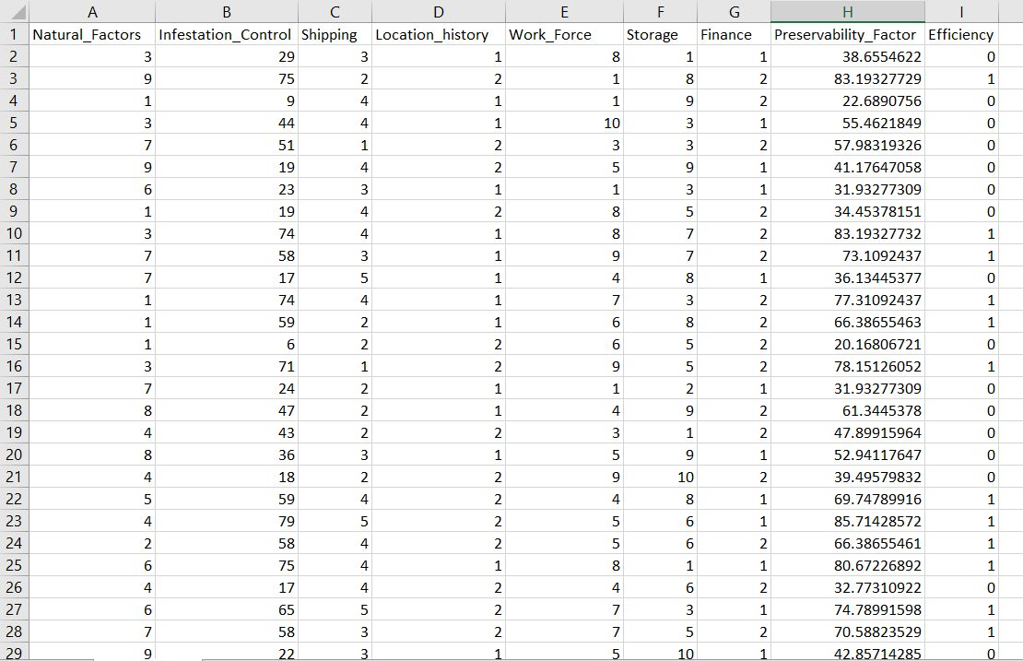
DATASET

Slide 6
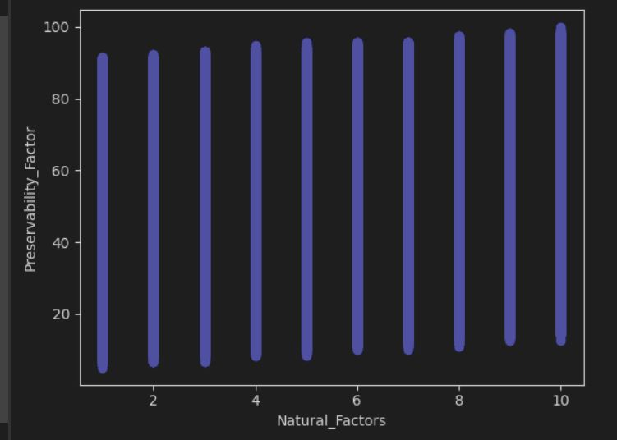
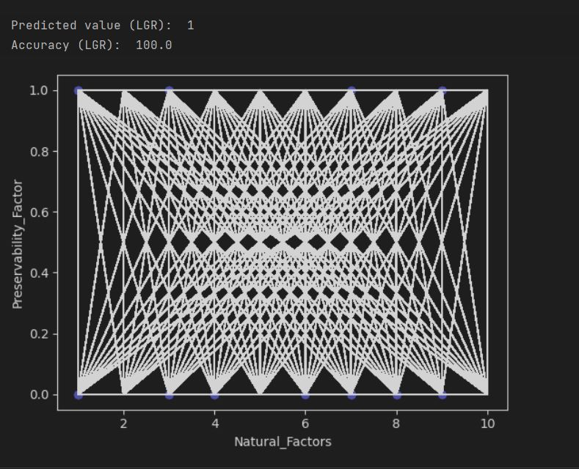
CODE AND OBSERVATIONS

Slide 7
APPLICATION AND FEATURE THOUGHTS
Preservability can be found easily.
We can classify the factors into preservable and non preservable conditions
We are looking forward to make this dataset much more relevant to out real world and train the algorithm much more effectively
It might be a sensation If any industry can implement this data science in their business field

